Slide 1
DOES WEALTH PLAY A ROLE IN LIFE EXPECTANCY
CASE STUDY IN THE CITY OF BARCELONA
Adrián Larrea
DA FT Nov21st

Slide 2
TABLE OF CONTENTS
01
02
ANALYSIS
GENERAL DATA INSIGHTS
03
04
CONCLUSIONS
NEXT STEPS

Slide 3
01
GENERAL DATA INSIGHTS

Slide 4
GENERAL DATA INSIGHTS
NATIONAL INSTITUTE OF STATISTICS
TARGET : AVERAGE LIFE EXPECTANCY
1.636.732 citizens
RANGING FROM 2005 TO 2021

Slide 5
GENERAL DATA INSIGHTS
QUESTION
HYPOTHESIS
MODEL
Does Wealth have a significant impact on life expectancy?
H0: there is no relationship between salary and life expectancy
H1: there is a relationship between salary and life expectancy
Predict lifespan through avg.household income
2
3
1
2
3

Slide 6
02
ANALYSIS

Slide 7
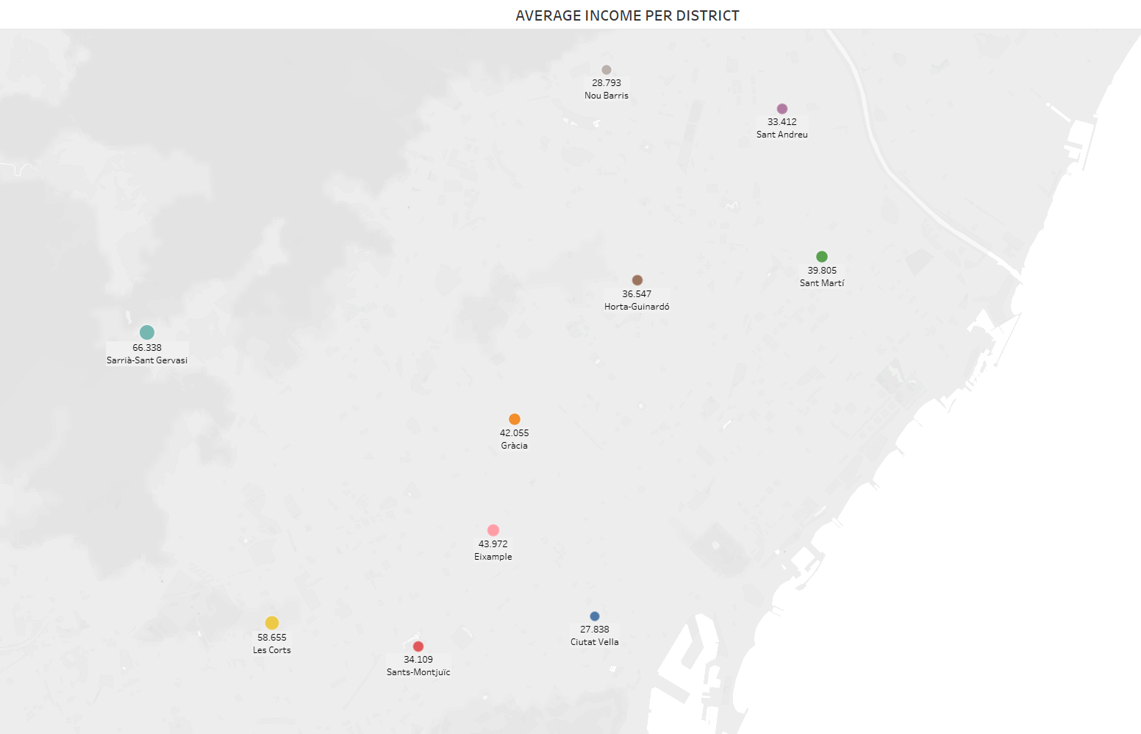
Sarrià-Sant Gervasi averages 66k per household
Ciutat Vella scores the lowest with 27,8k

Slide 8

Sarrià-Sant Gervasi averages 66k per household
Ciutat Vella scores the lowest with 27,8k

Slide 9

Sarrià-Sant Gervasi averages 66k per household
Ciutat Vella scores the lowest with 27,8k

Slide 10

Sarrià-Sant Gervasi averages 66k per household
Ciutat Vella scores the lowest with 27,8k

Slide 11
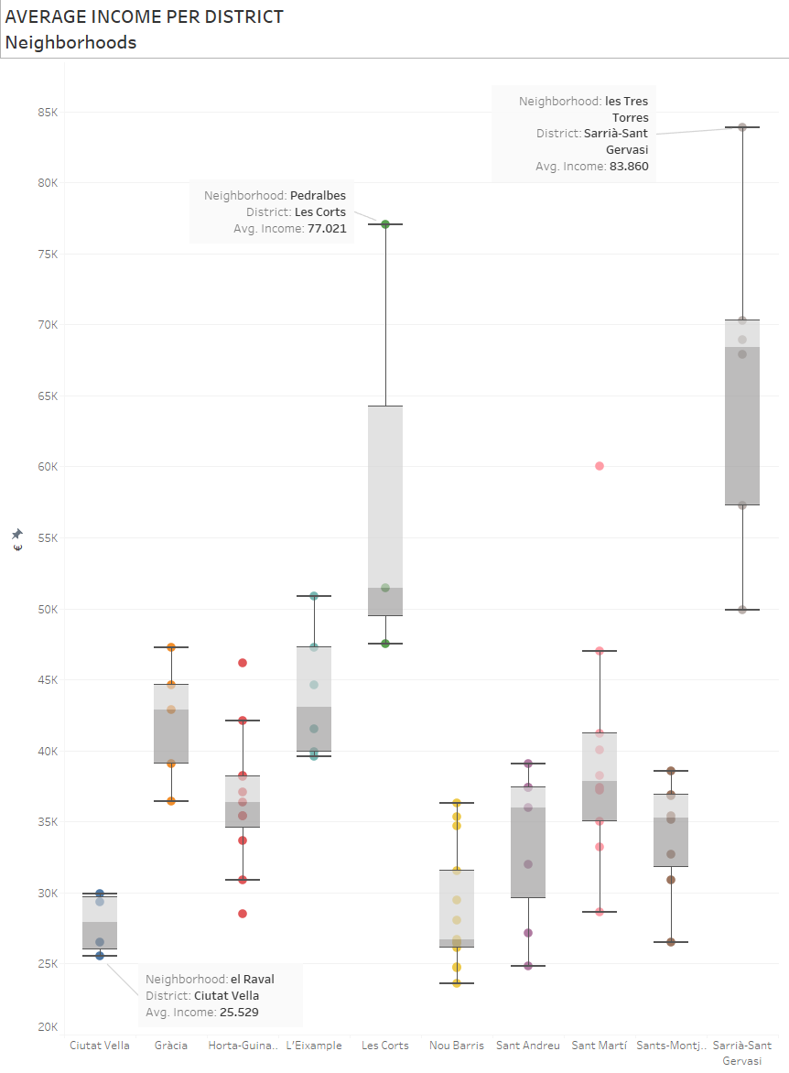
Two highest average income neihborhoods top the charts with yearly income above 77k
Lowest score is el Raval with 25,5k

Slide 12
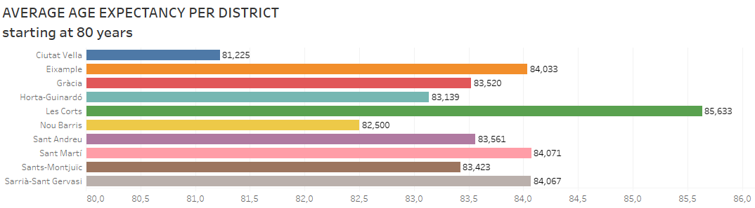
Ranging from 81,225 to 85,633
Ciutat Vella scores by far the lowest

Slide 13

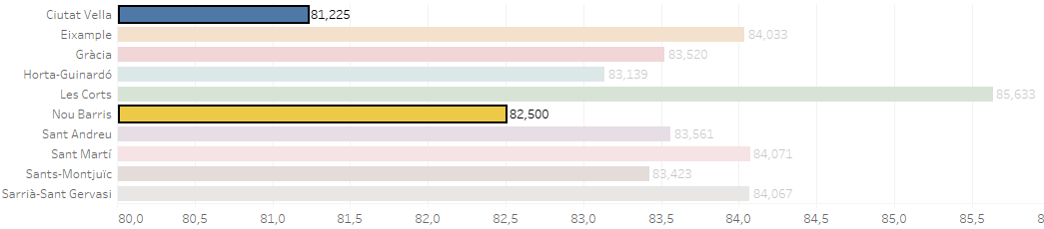
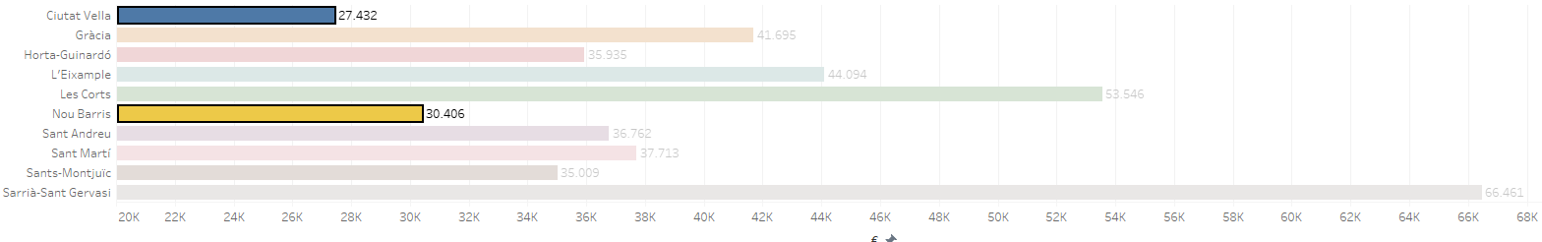

Slide 14
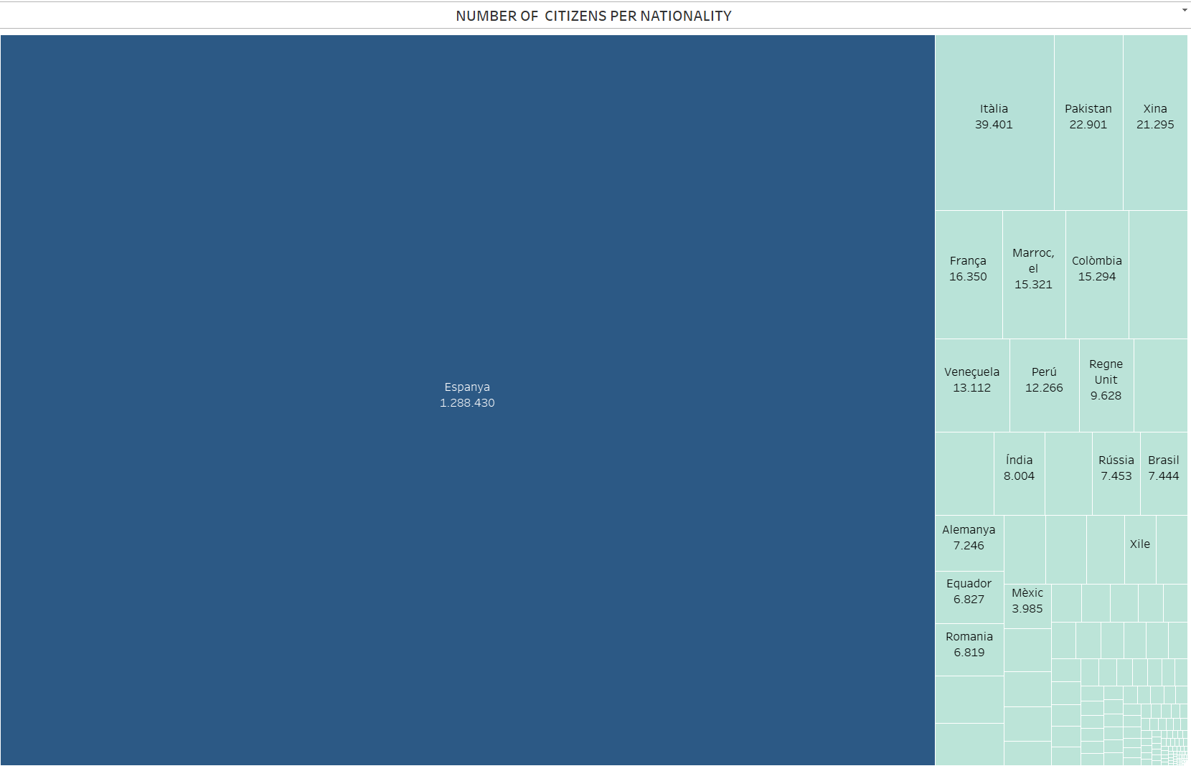

Slide 15
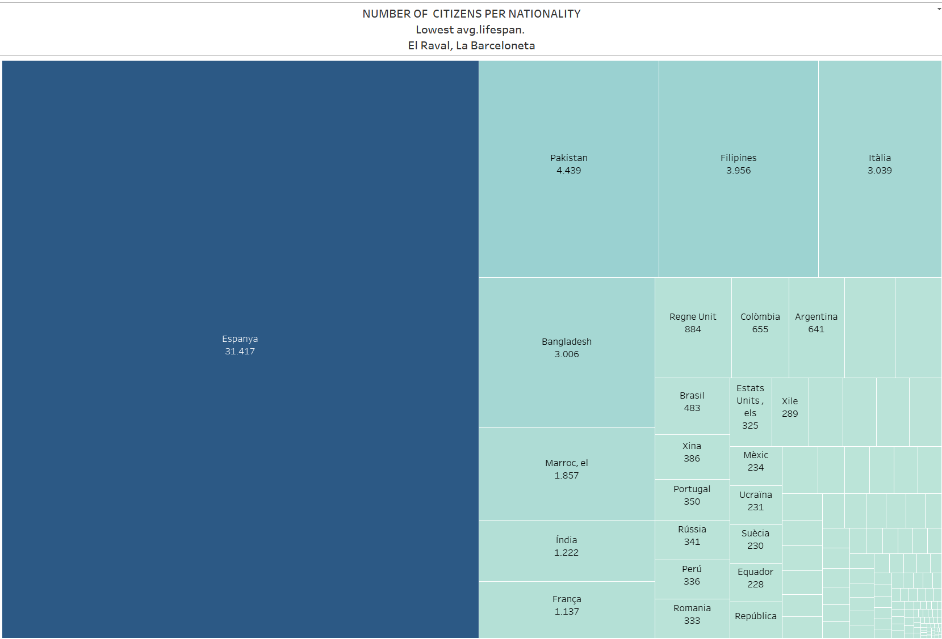

Slide 16


Slide 17


Slide 18


Slide 19


Slide 20
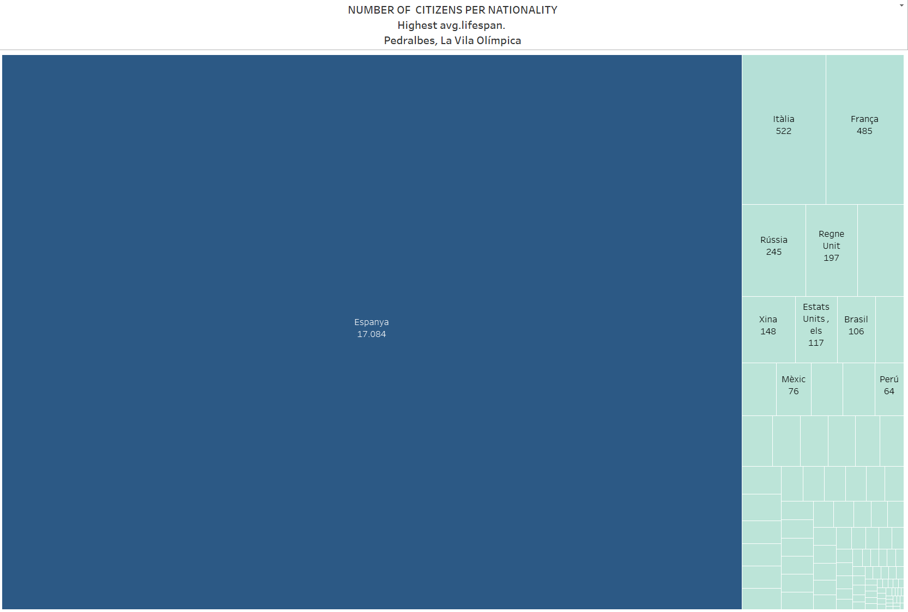

Slide 21
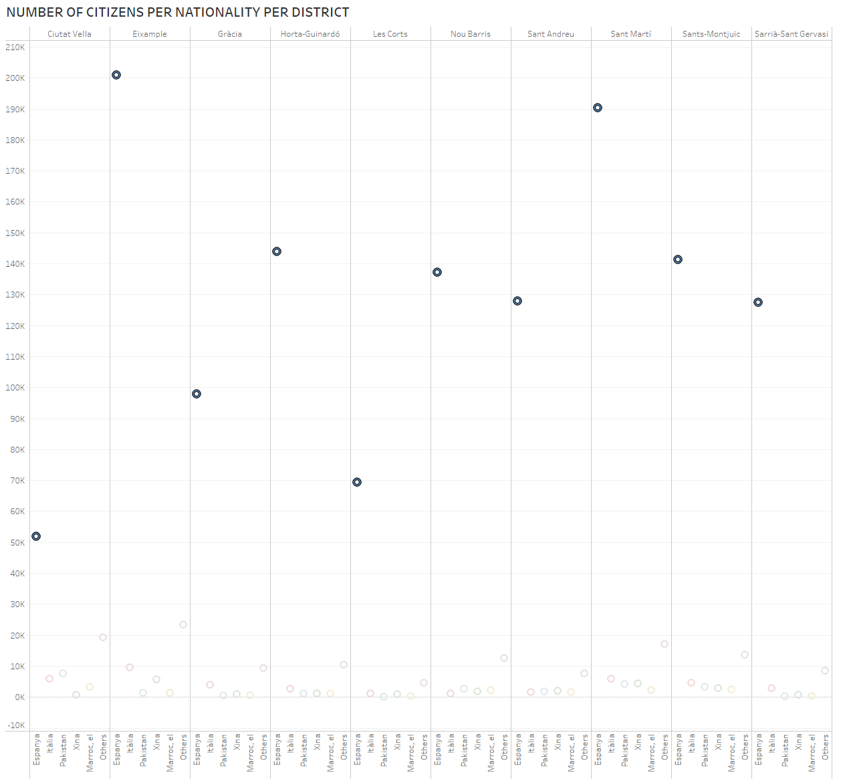
At a neighborhood level lifespan can be affected by nationality
By district, more than half of the popullation has spanish citizenship

Slide 22
03
CONCLUSIONS

Slide 23
CONCLUSIONS
GENDER MATTERS
NATIONALITY
LOCATION
HYPHOTHESIS
Avg. lifespan
Men 80,49
Women 86,96
With big samples, the effect dilludes
In this case does not have a sizeable effect
H0: there is no relationship between salary and lifespan
H1: there is a relationship between salary and lifespan
Correlation coefficient: 0.4864403037530524
P-value: 1.2808385437126762e-05

Slide 24
04
NEXT STEPS

Slide 25
IMPROVING THE ANALYSIS
Adding additional key features:
-Eating habits
-Social life
-Pollution ratios
-Physical activity
01
02
Getting a larger dataset
Run the model with unseen data
03
04
Use different model to make predictions
Run models binning in avg. income to find the tipping point

Slide 26
THANKS
Data source:
https://opendata-ajuntament.barcelona.cat/
https://www.123coordenadas.com
https://datos.gob.es/es

